Slide 1
ABROMA AUGUSTA

Slide 2
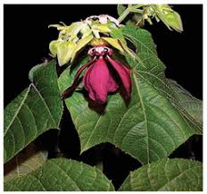

Slide 3
Common name - Devil's Cotton, Olat Kambal, Olak Tambol
Prover – Dr D N Ray
It grows in various states of India.
Pharmaceutical use
Leaves and root.
Family
Sterculiaceae.

Slide 4
Tincture is made from the leaves of the plant

Slide 6
THERAPEUTIC ACTIONS
Cures diabetes(DM, DI)
Dysmenorrhoea
Weakness of brain
It is often used in the treatment of wounds, abscess and carbuncle of the diabetic patients.
In albuminuria it gives wonderful result.

Slide 7
Effective physiological responses:
In cases of pains, dysmenorrhoea, skin diseases, diabetes, Insomnia, weakness, rheumatic pain, giddiness, albuminuria etc; the effect is much better.

Slide 8
Physio-chemical action:
This drug is used as an uterine tonic; in the treatment of congestion and various dysmenorrhoea.
It regulates the menstrual flow.

Slide 9
MIND
Hot tempered
Easily irritated
Insomnia
Cannot concentrate mind
Depression, dislike for active work
Contradiction unbearable

Slide 10
Sleepless night, at times full of dreams of various things
Forgetfulness
Absent-minded.
HEAD
Giddiness, tendency to vomit, emptiness of the head; headache.

Slide 11
Pain on the back of the head
Tight feeling on the side of the head; worse morning due to heaviness of head
Better in open air, burning in vertex.
Rolling of head

Slide 12
EYES
Weak-sightedness due to suffering from diabetes
Paleness and heaviness due to insomnia.
Puffiness of the lids
Conjunctiva becomes pale

Slide 13
EARS
Buzzing sound in the ears, hard of hearing.
Thin, white pus discharge, thick, whitish, from right ear, sticky.

Slide 14
FACE
Pale, wrinkled, old looking
Furuncles on the face
NOSE
Frequent sneezing associated with headache.
Coryza with cough and low grade fever
Desire to rub.

Slide 15
MOUTH
Dryness of the mouth, almost constant, with desire for drinking large quantities of cold water
TONGUE
Clean and dry

Slide 16
THROAT
Painful swallow
Difficulty in swallowing solids
Prefers liquid diet.
Dry, burning sensation

Slide 17
RESPIRATORY SYSTEM
Throbbing sensation with heaviness as if something has been put on the chest.
Lumpy sputum- whitish / yellowish
< cold air, evening, night
During cough, patient holds the chest

Slide 18
HEART
Palpitation, < on movement
Acute pain.
Weakness of the heart with faint feeling

Slide 19
APPETITE
Tendency to take food continuously
Non appeasing of hunger.
Desire for all kinds of food, sweets, acids, fish and meat, rice, bread; not satisfied with eating
STOOL
Constipation; stiff stool in black lumps.
Hard, dry, knotty and frothy.
Stool passes with much straining.

Slide 20
URINE
Diabetes, urinal discharge ; starchy urine; Urine of high specific gravity.
Fishy odour of urine
Nocturnal enuresis

Slide 21
Profuse urination both day and night
Passage of urine, very large quantity every time
Passes urine every two hours; desire to drink after urination

Slide 22
MALE SEXUAL SYMPTOMS
Wound of the urethra caused by urine containing starch
Frequent urination at night.
Absence of sexual desire
Inability to coition

Slide 23
FEMALE SEXUAL SYMPTOMS
Irregular menstruation; Dysmenorrhoea
Severe pain of the pelvis during menstrual discharge
Scanty or profuse discharge of clots of dark red blood
Colicky pain in the lower abdomen 2 to 3 days before menses

Slide 24
Pain in the hands and legs followed by weakness
The patient lacks energy to leave bed; sometimes convulsion like hysteria
Ovaritis, ovarian neuralgia, vaginismus, menstrual colic etc.
Leucorrhoea thin, watery, profuse,white

Slide 25
EXTREMITIES
Weakness and backache.
Lack of energy
Pain in the kidney region

Slide 26
SKIN
Dry skin with scabies, aggravation at night
Small pimples, carbuncle, skin disease of the diabetic patient.

Slide 27
SLEEP
Not enough, drowsiness
Aversion to do any labour
Unrefreshed sleep
Sleeps better in the early part of the morning

Slide 28
Dose
10-20 gtt in tincture form
Powder form 5-6 grain four times a day.
It is a valuable substitute for Hydrastis, Viburnum and Pulsatilla

Slide 29
???????????

Slide 30
????????????

Slide 31
???????????

Slide 32
???????????

Slide 33
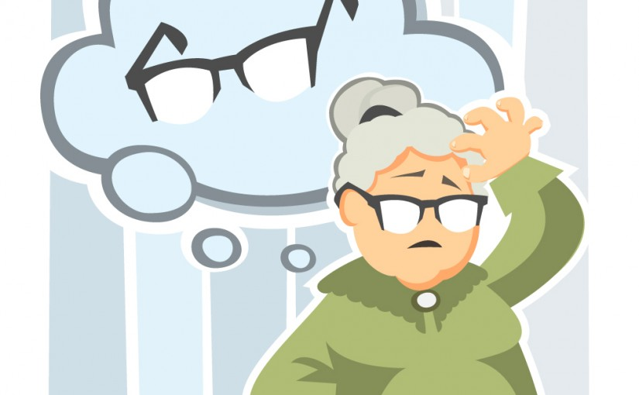
????????????

Slide 34
??????????

Slide 35
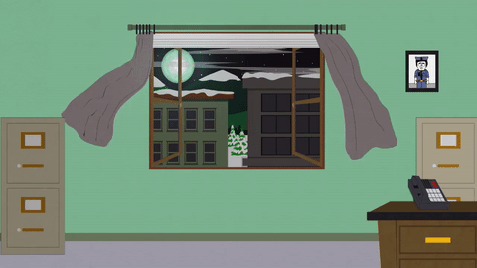
????????

Slide 36
?????????????

Slide 37
????????????

Slide 38
???????????

Slide 39
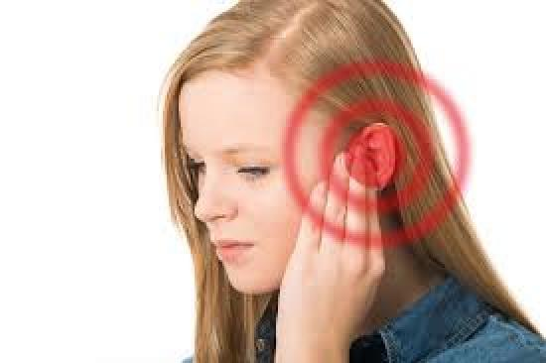
??????????

Slide 40
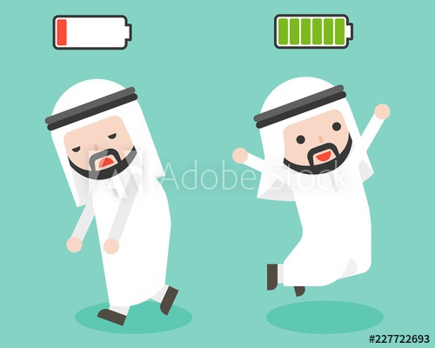
???????????

Slide 41
????????

Slide 42
???????????

Slide 43
???????????

Slide 44
?????????????

Slide 45
??????????????

Slide 46
?????????

Slide 47
?????????????

Slide 48
?????????????

Slide 49
???????????

Slide 50
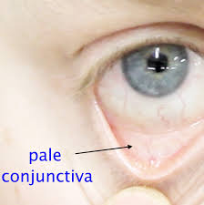

Slide 52
THANK YOU ALL………..

